Slide 1
Comparing the Venues of Downtown Toronto and Manhattan

Slide 2
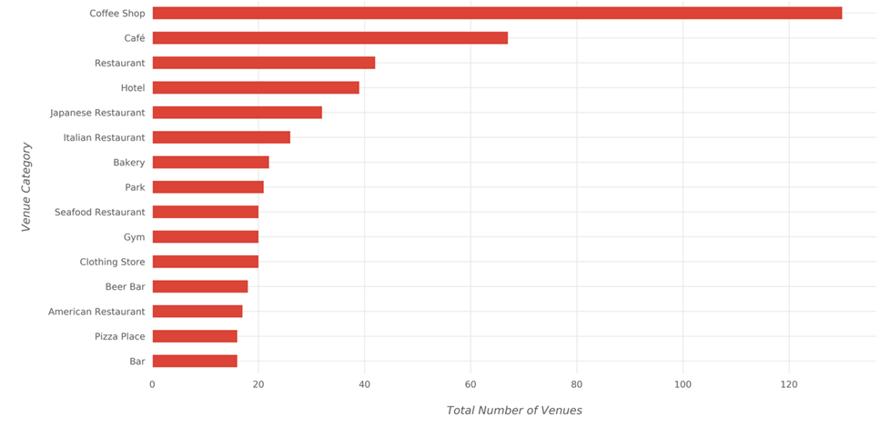
Most Common Venue Categories (Downtown Toronto)

Slide 3
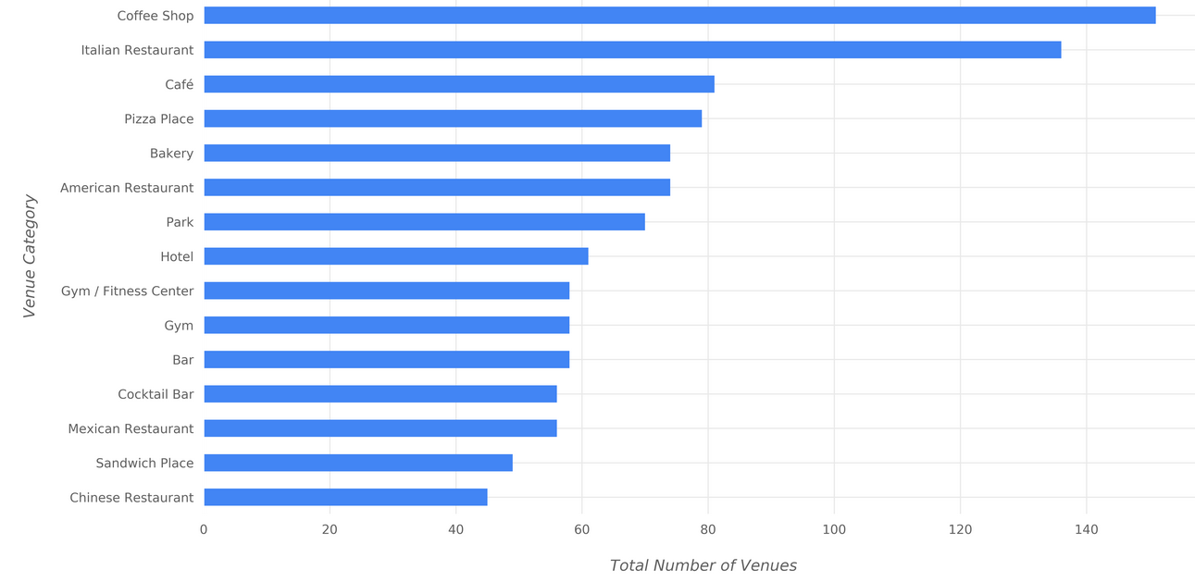
Most Common Venue Categories (Manhattan)

Slide 4
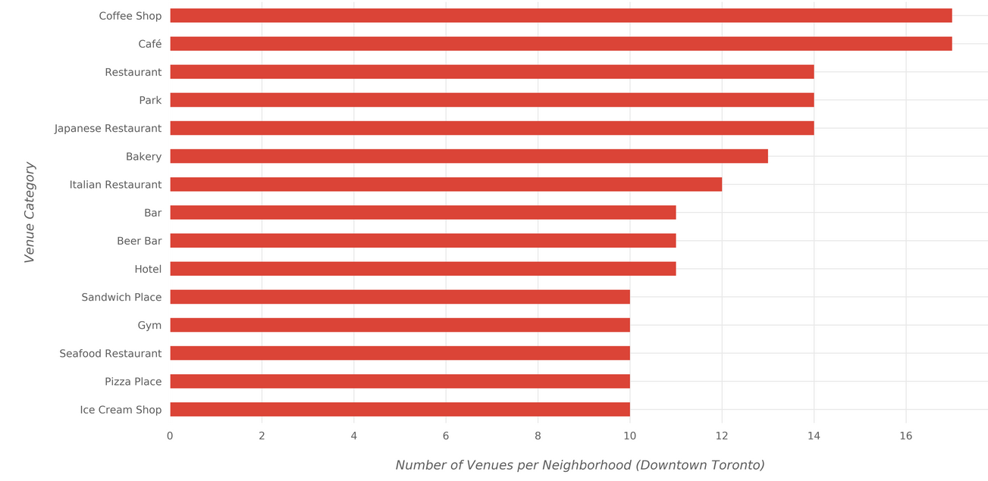
Most Venues Per Neighborhood (Downtown Toronto)

Slide 5
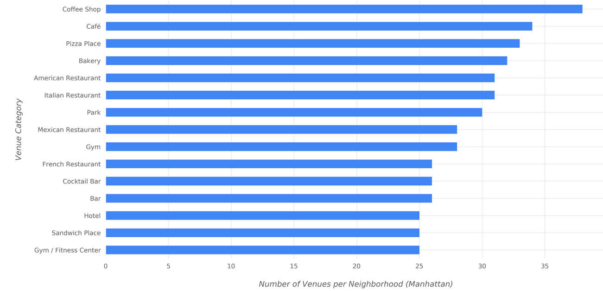
Most Venues Per Neighborhood (Manhattan)

Slide 6
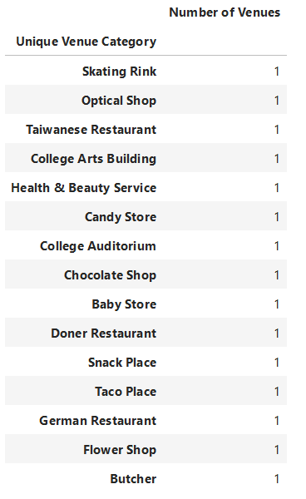
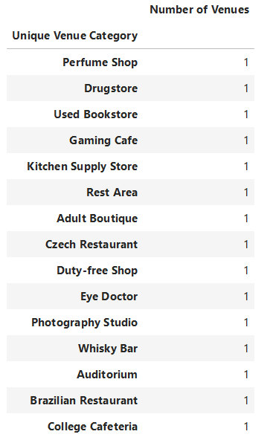
Unique Venues Toronto Vs Manhattan

Slide 7
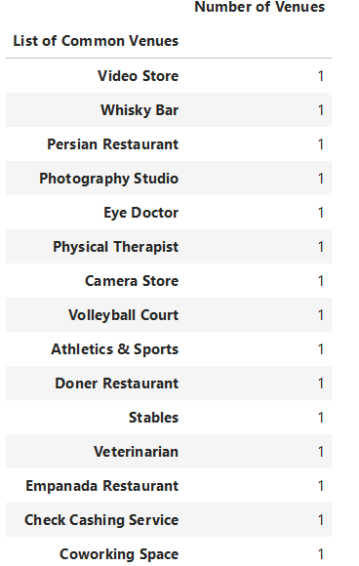
Common Unique Venues between Toronto & Manhattan

Slide 8
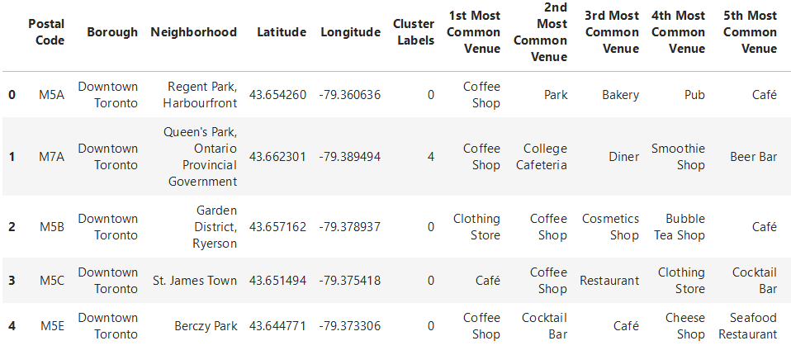
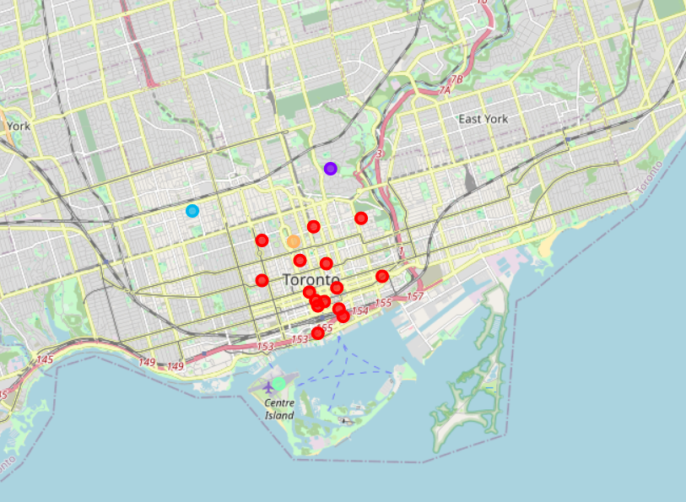
Cluster Analysis (Downtown Toronto)
Clusters of similar venues

Slide 9
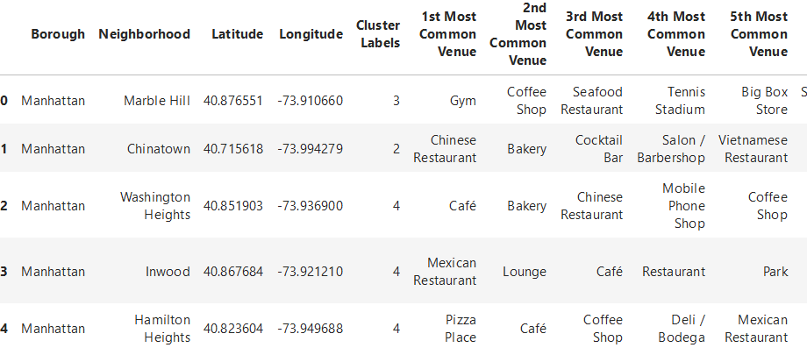
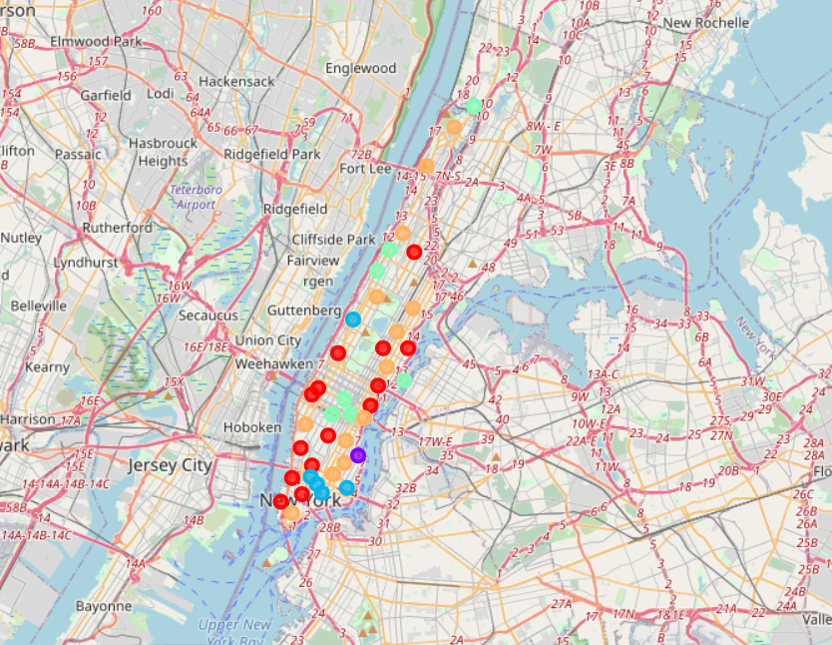
Cluster Analysis (Manhattan)
Clusters of similar venues

Slide 10
Conclusion
Some venue categories are more common in some cluster than the others.
The most common venue categories differ from one cluster to the other.
If a deeper analysis—taking more aspects into account—is performed, it might result in discovering different style in each cluster based on the most common categories in the cluster.

